Slide 1

Course Registration Project
Hello and welcome
Ronnie Liu
Register your course today!
Future Junior Developer

Slide 2
Agenda for
Today
01
02
03
Technologies
Demo
Q&A
Course Registration

Slide 3
Assumption
Time Constraint for Preferred Start Date
Within one year from today

Slide 4

Front End
About Technologies
Bootstrap – create the form and the feedback section
Lightweight and customizable
Responsive structure
JQuery – communicate with server side and validate the form
Easy to use and Ajax support
Backend
ASP.NET Core – robust web application
cross-platform, open-source framework
good separation between layers of the application
easy integration with the whole of ASP.NET
Serilog
Structured logging and enrichment
Go to Demo

Slide 5

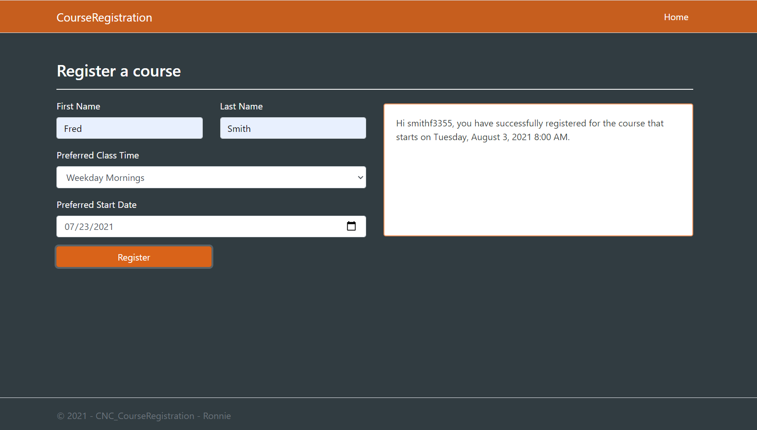
Demo
Course Registration

Slide 6

Thank You
for Attention!
Ronnie Liu

